Slide 1

Migration of video learning project
Group Name : Code Breakers
Group Members:
Nusrat Jahan Sumi (1345476)
Mashnunul Huq (1384042)

Slide 2
Content
INTRODUCTION
HTM SPATIAL POOLER
SEQUENCE LEARNING
METHODOLOGY
IMPLEMENTATION OF ALGORITHM
CONCLUSION
REFERENCE

Slide 3
INTRODUCTION
Hierarchical temporal memory(HTM) is a theoretical framework that represents several structural and algorithmic properties of the neocortex.
The HTM algorithm is designed with supervised or unsupervised learning data.
The algorithm learns with the help of a hierarchical network and a continuous stream of input data.
The success of HTM depends on the use of sparse distributed representations(SDRs)

Slide 4
HTM SPATIAL POOLER
Spatial pooler plays a vital role in HTM networks.
In an end-to-end HTM system, the SP transforms input patterns into SDRs in a continuous online fashion.
The HTM temporal memory learns temporal sequences of these SDRs and do the predictions for future inputs.
Different cells within a mini-column represent this feedforward input in different temporal contexts.

Slide 5
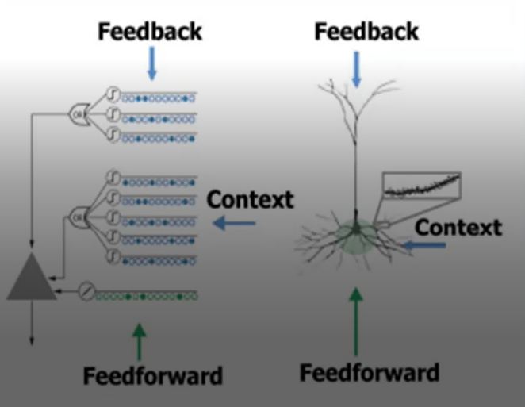
Continue
Cells in a mini-column share the same feedforward classical receptive field.
In this way SP models common receptive field is learned from the input.
The SP output define the activation of mini-columns in response to feedforward inputs.

Slide 6
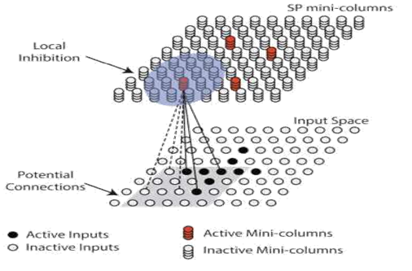
Continue
A signal layer in an HTM network is structured as a set of mini-columns, each mini-columns consist of a set of cells.
Each SP mini-column forms synaptic connections to a population of input neurons.
The dimensionality of the input space depends on the applications.
At any time, only a small fraction of the mini-columns with the most active inputs become active.

Slide 7
SEQUENCE LEARNING
At the time of building intelligent systems to mimic human intelligence and cognition, we must pay serious attention to sequences, including sequence learning as sequential behavior is essential to intelligence.
Learning hierarchical structures help to reduce or eliminate temporal dependencies. It helps to compress the description or sequences.
Sequence learning which indicates either generation, prediction or recognition is usually based on the models of legitimate sequences which can be developed through training with exemplars.

Slide 8
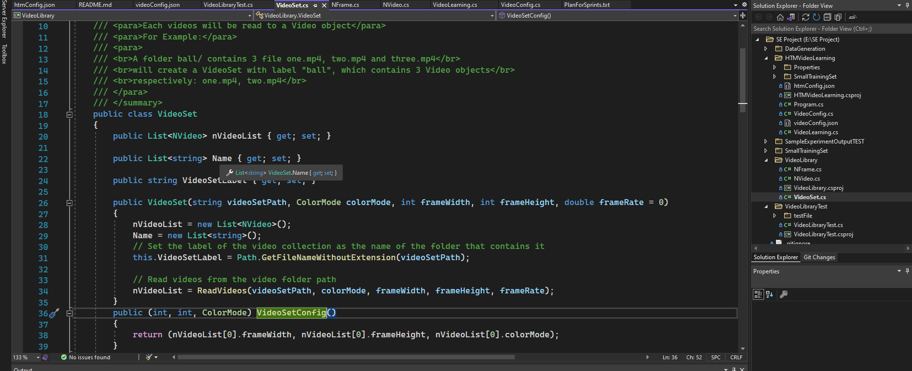
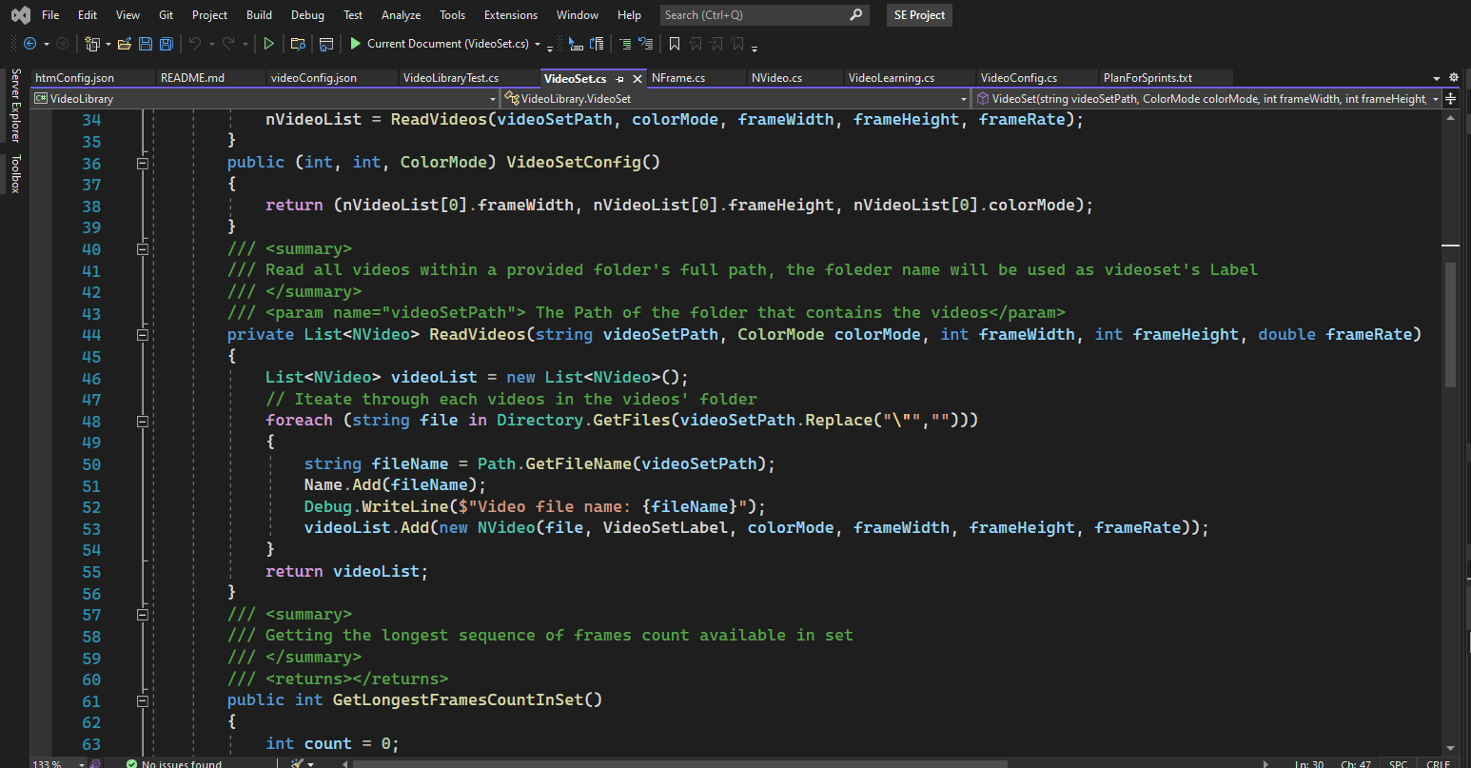
METHODOLOGY

Slide 9
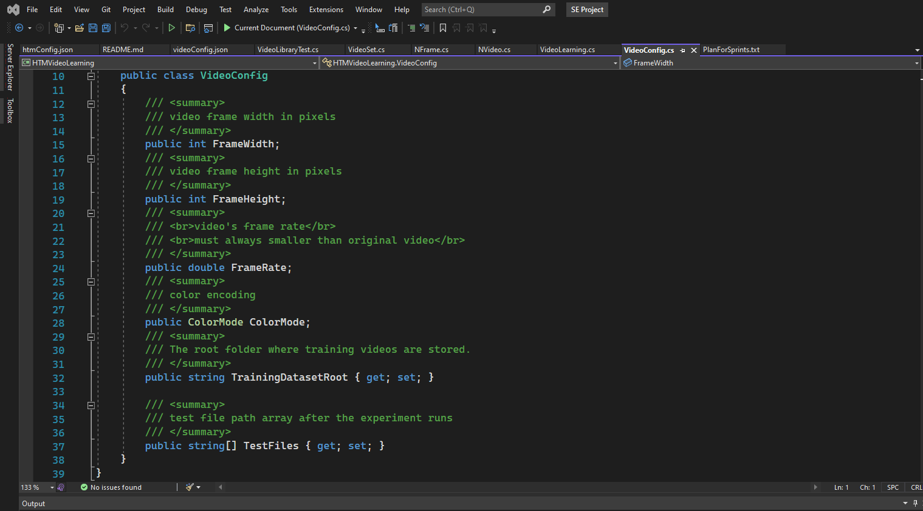
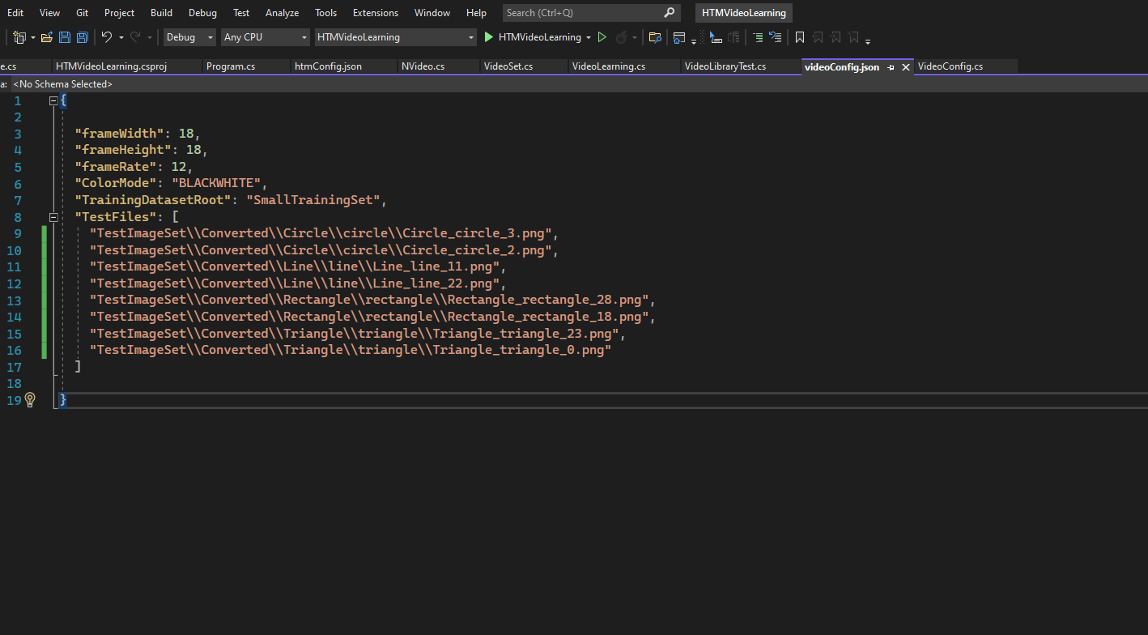
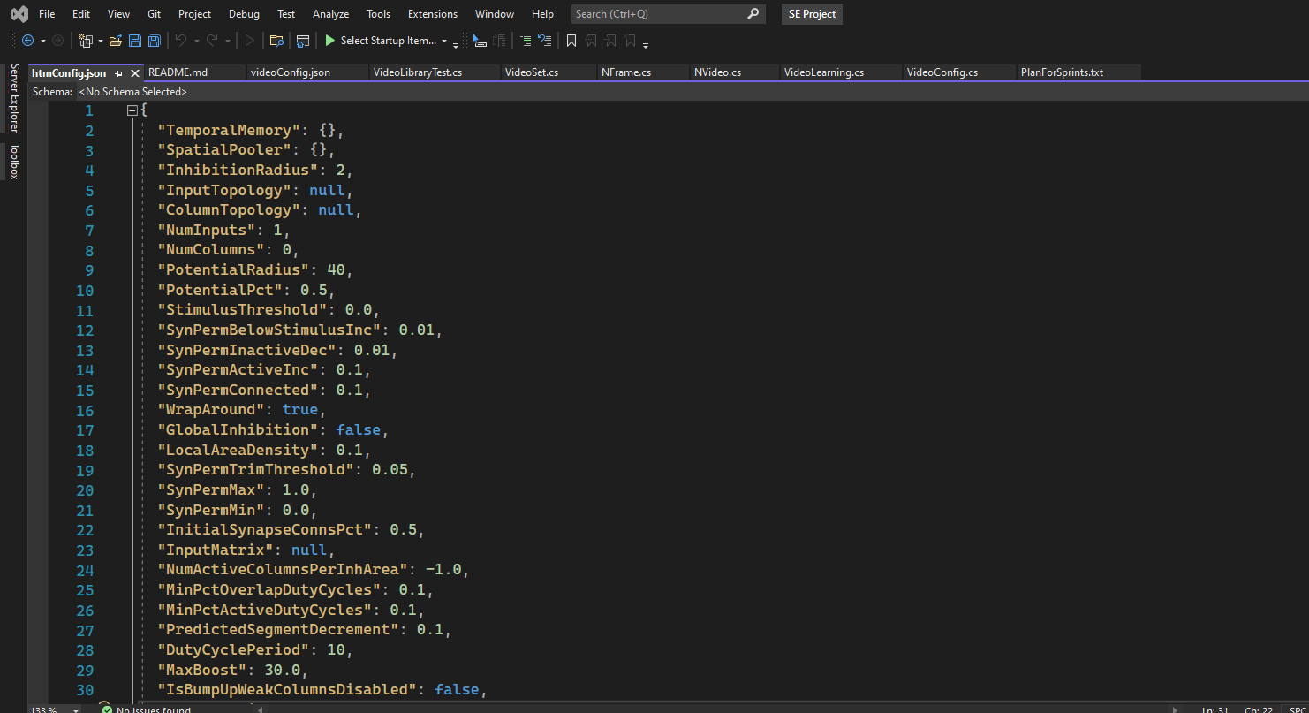
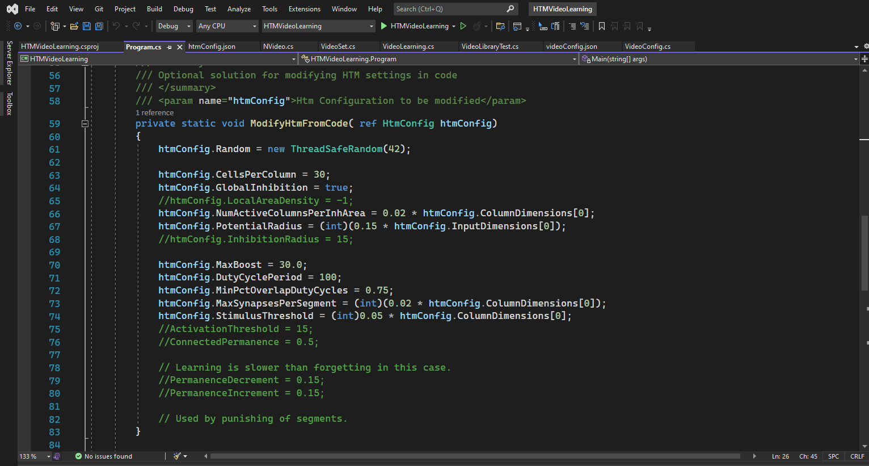
Continue

Slide 10
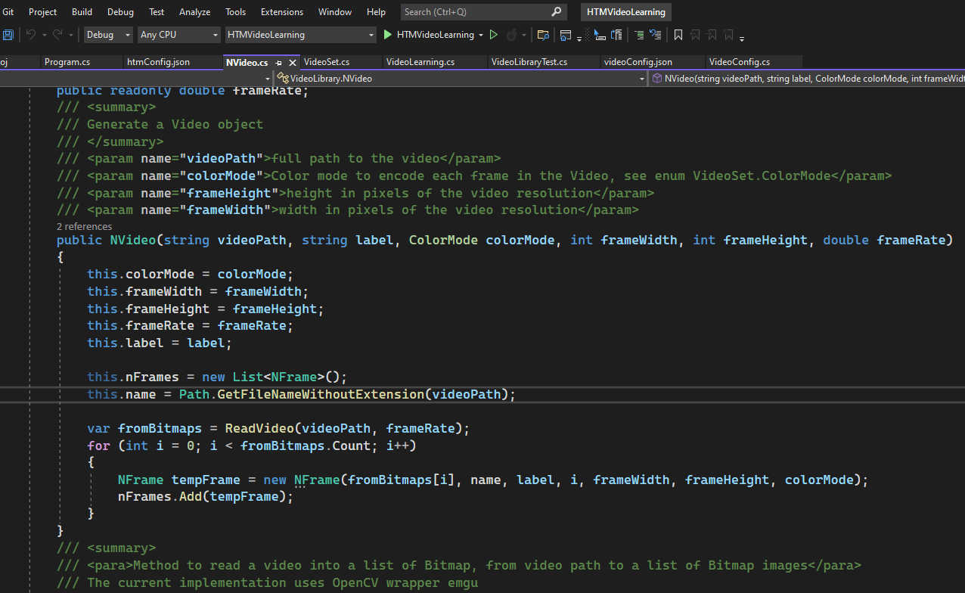
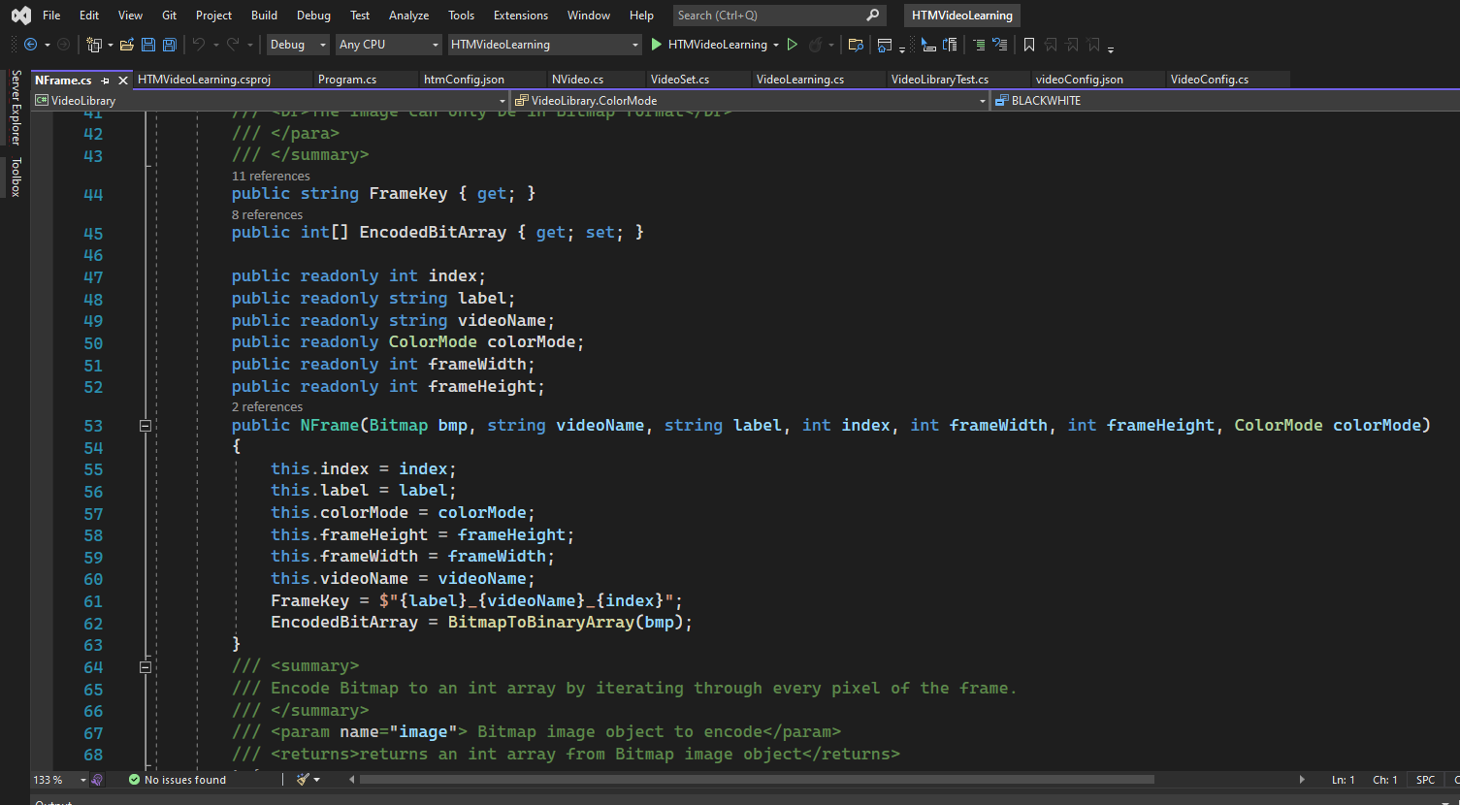
Continue

Slide 11
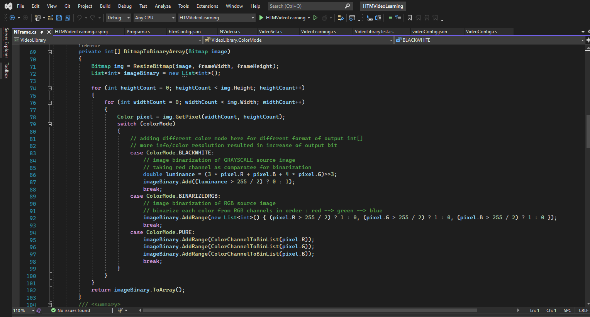
Continue

Slide 12
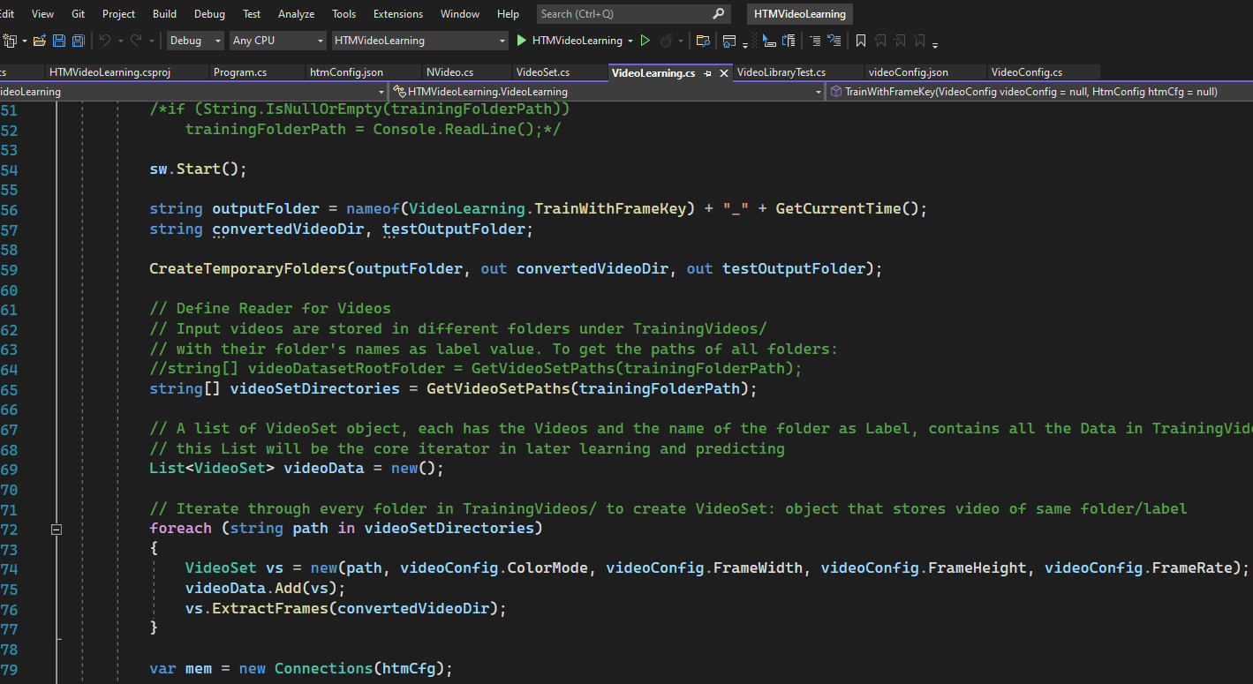
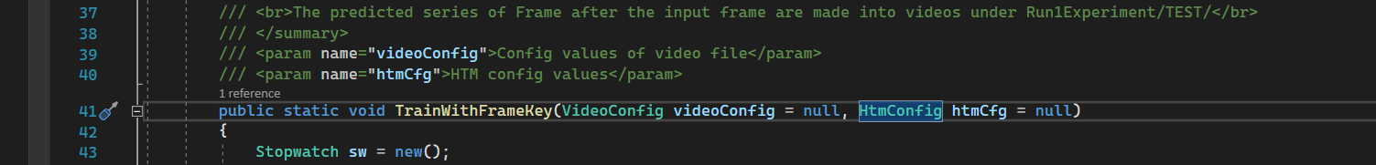
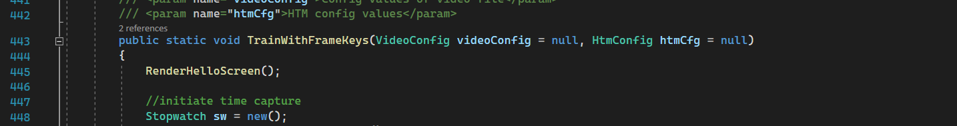
Continue

Slide 13
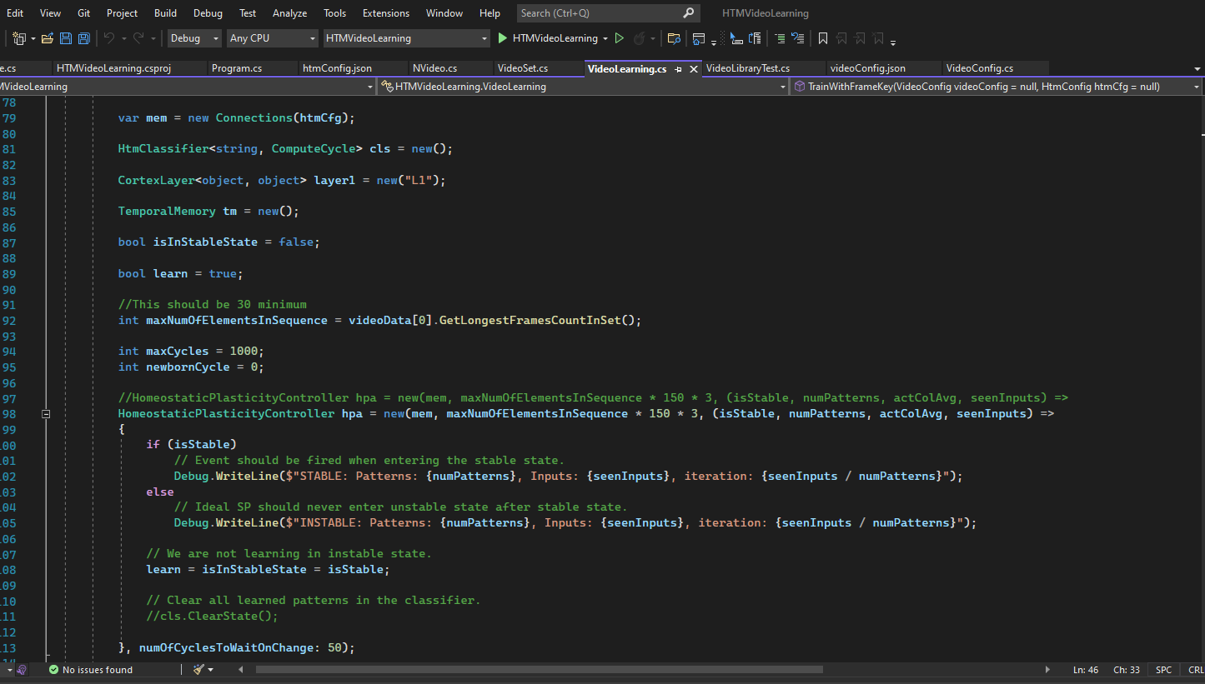
Continue

Slide 14
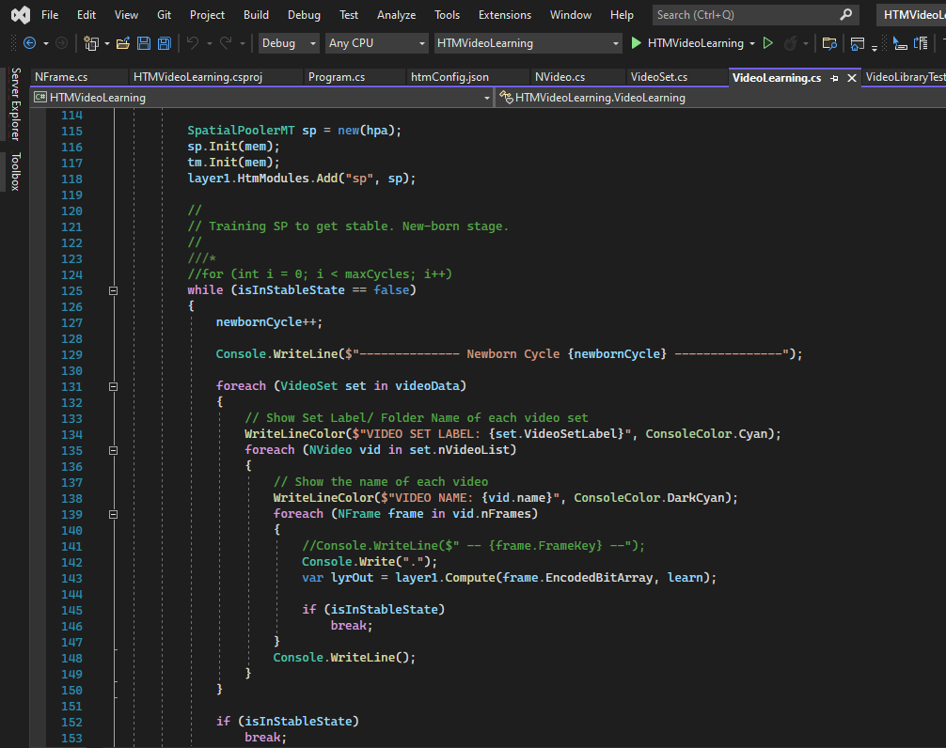
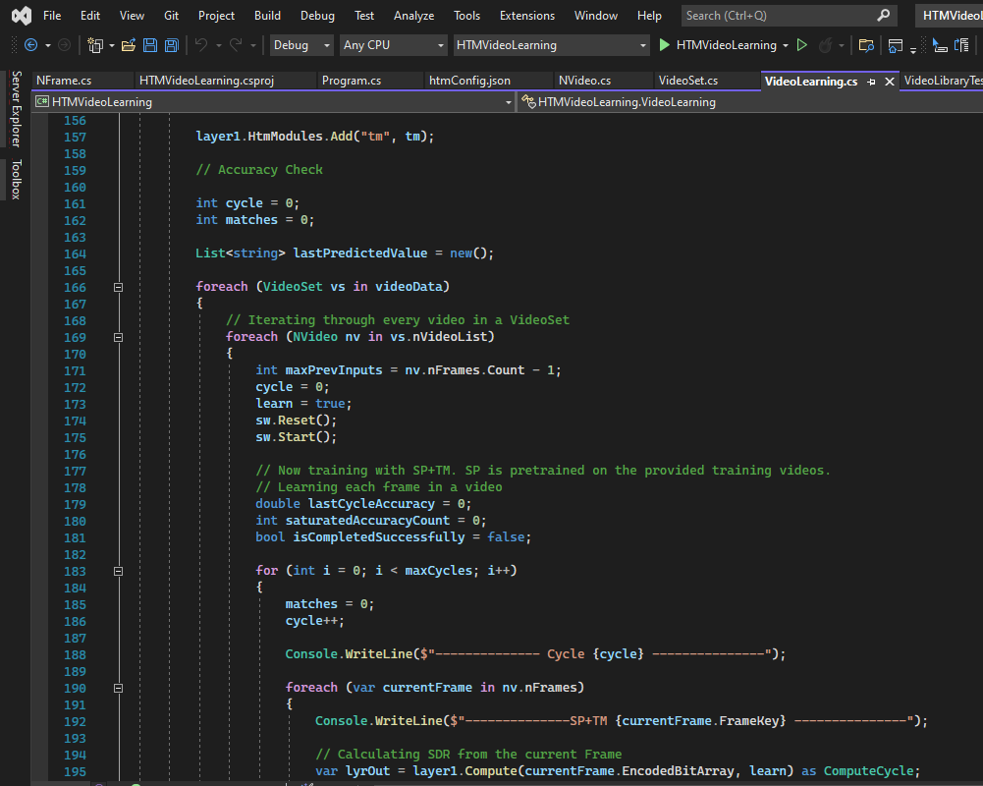
Continue

Slide 15
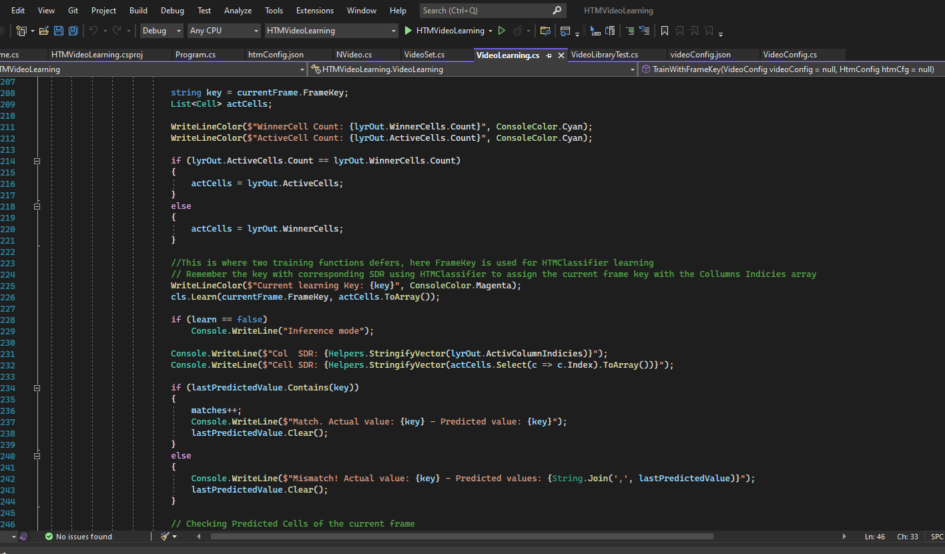
Continue

Slide 16
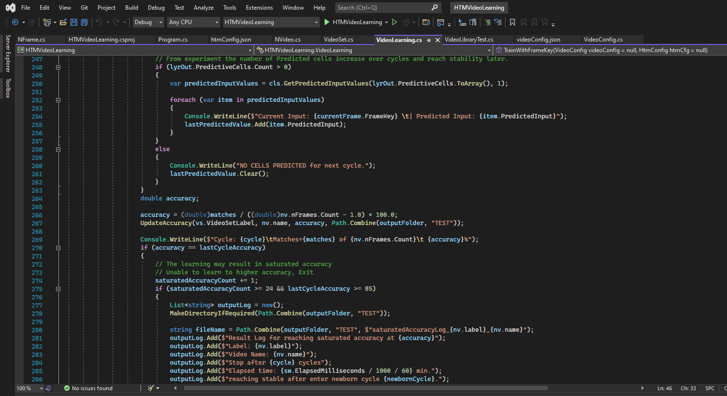
Continue

Slide 17
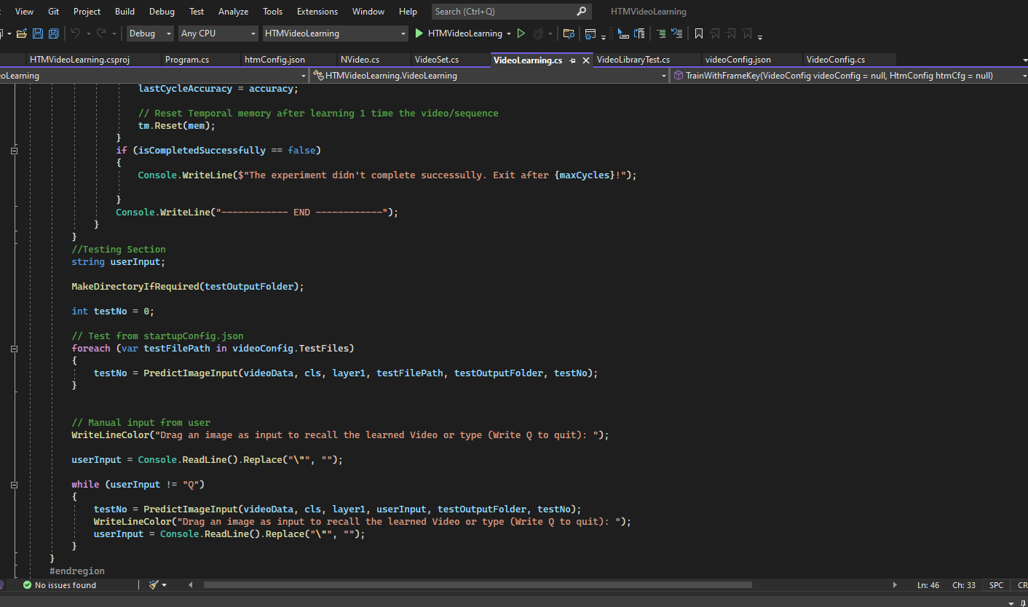
Continue

Slide 18
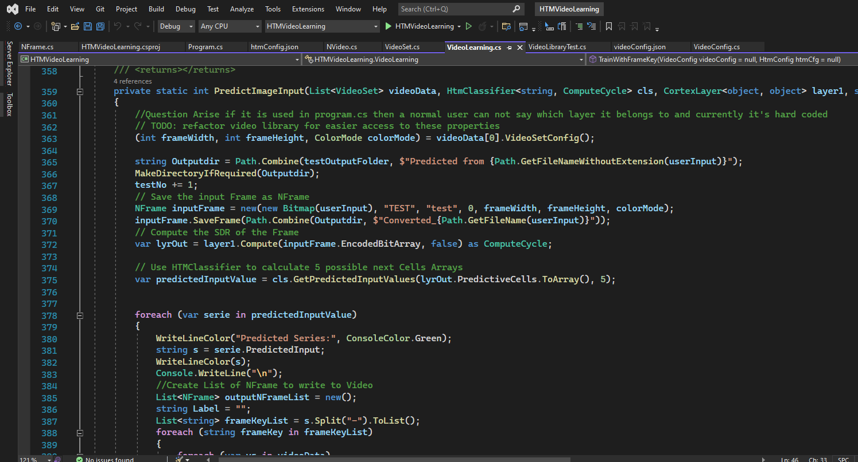
Continue

Slide 19
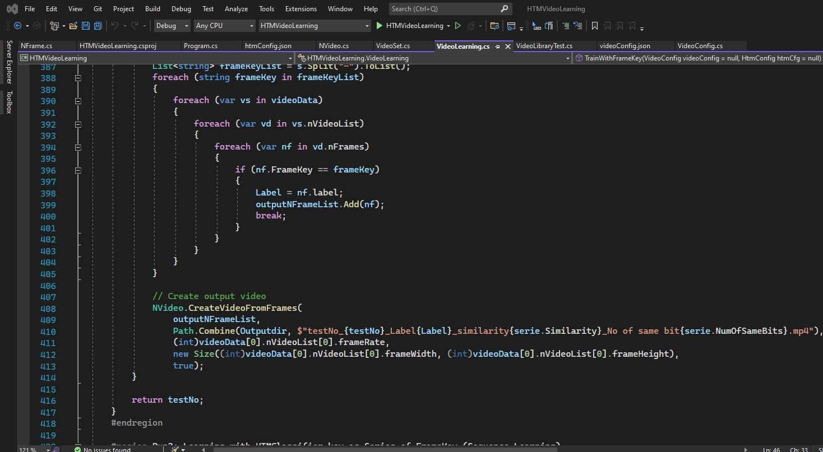
Continue

Slide 20
IMPLEMENTATION OF ALGORITHM
Pseudo Code:
Define and Read Video configuration and HTM configuration from videoConfig.json and htmConfig.json
Define the output folder and test output folder, if necessary make temporaryfolder
Read from every video and save the encoded frames in converted video directory
Instantiate HomeostaticPlasticityController with htm configuration set above
Until reaching stable state learn with the encoded frame creating SDR from SP and TM
Run through each video’s each frame and for sequential learning learn with one framekey
or for multisequence learning learn with 3 frames
Predict 1 possible next frame for the current frame in sequence learning
Or predict 1 frame from 3 possible next frames for it in multisequence learning
Check if the predicted frame matches with the current frame, if it matches increase matched frame count
Calculate the accuracy for the current video set
If the accuracy reaches to saturation for 24(for sequential) or 10(for multisequence) record the accuracy
with iteration numbers
Try to predict frames for the test files given in the videoConfig.json and make the video file with predicted frames
Take image input from user and predict frames and make the video file with predicted frames
Terminate when user inputs “Q”

Slide 21
CONCLUSION
Data Type | Highest Accuracy | Saturated Accuracy
Circle | 102.857% Stability reached at 185th newborn cycle | 102.85714285% Saturation level fixed at 117th cycle
Line | 100% Stability reached at 185th newborn cycle | 95.74468085% Saturation level fixed at 447th cycle
Rectangle | 100% Stability reached at 185th newborn cycle | 100% Saturation level fixed at 144th cycle
Triangle | 100% Stability reached at 185th newborn cycle | 100% Saturation level fixed at 127th cycle
Data Type | Highest Accuracy | Saturated Accuracy
Circle | 102.857% Stability reached at 177th newborn cycle | 102.8571428% Saturation level fixed at 69th cycle
Line | 97.87% Stability reached at 177th newborn cycle | 97.8723404% Saturation level fixed at 217th cycle
Rectangle | 100% Stability reached at 177th newborn cycle | 97.1428571% Saturation level fixed at 77th cycle
Triangle | 100% Stability reached at 177th newborn cycle | 100% Saturation level fixed at 17th cycle
Sequential Learning
Multisequence Learning

Slide 22
CONCLUSION
Input Picture Sequence | Possible Matches Found
Circle_circle_2.png | 60.36% match with Triangle_19 31.95% match with Triangle_27 3.99% match with Circle_1 3.55% match with Triangle_26 3.43% match with Circle_4
Circle_circle_3.png | 10.45% match with Circle_1 8.2% match with Triangle_18 8.2% match with Triangle_20 8.2% match with Triangle_26 7.4% match with Triangle_25
Line_line_11.png | 13.61% match with Line_30 9.77% match with Line_13 9.42% match with Triangle_10 9.42% match with Triangle_34 5.58% match with Triangle_35
Line_line_22.png | 12.02% match with Triangle_28 10.18% match with Line_4 8.35% match with Triangle_27 7.5% match with Rectangle_1 6.84% match with Triangle_17
Rectangle_rectangle_18.png | 15.16% match with Triangle_2 14.29% match with Triangle_3 14.29% match with Triangle_10 12.09% match with Triangle_12 10.56% match with Triangle_1
Rectangle_rectangle_28.png | 25.41% match with Triangle_5 15.14% match with Triangle_9 9.19% match with Triangle_32 9.06% match with Rectangle_3 7.57% match with Triangle_6
Triangle_triangle_23.png | 96.18% match with Triangle_1 27.32% match with Rectangle_1 24.51% match with Triangle_2 7.39% match with Rectangle_2 6.36% match with Rectangle_5
Triangle_triangle_0.png | 11.93% match with Triangle_22 11.93% match with Triangle_24 11.7% match with Triangle_23 8.19% match with Circle_1 7.02% match with Triangle_25
Input Picture Sequence | Possible Matches Found
Circle_circle_2.png | 34.85% match with Triangle_20 32.58% match with Circle_24 31.82% match with Circle_4 25.76% match with Rectangle_17 14.39% match with Triangle_28
Circle_circle_3.png | 39.3% match with Triangle_21 14.17% match with Rectangle_16 13.9% match with Circle_2 12.03% match with Triangle_28 10.43% match with Circle_23
Line_line_11.png | 61.24% match with Rectangle_13 60.47% match with Reactangle_21 21.71% match with Line_13 19.38% match with Triangle_0 18.6% match with Line_32
Line_line_22.png | 18.63% match with Triangle_29 7.14% match with Triangle_28 4.9% match with Line_24 4.9% match with Line_42 3.92% match with Line_5
Rectangle_rectangle_18.png | 20.55% match with Triangle_35 14.68% match with Triangle_11 4.9% match with Triangle_34 4.35% match with Triangle_12 2.94% match with Triangle_3
Rectangle_rectangle_28.png | 27.78% match with Triangle_6 21.96% match with Triangle_33 14.81% match with Rectangle_28 12.96% match with Rectangle_4 11.38% match with Triangle_34
Triangle_triangle_23.png | 91.45% match with Triangle_2 16.67% match with Triangle_14 14.53% match with Triangle_30 13.68% match with Triangle_3 10.26% match with Rectangle_19
Triangle_triangle_0.png | 32.13% match with Triangle_23 29.72% match with Triangle_24 26.51% match with Triangle_25 4.42% match with Rectangle_33 3.61% match with Triangle_22
Limitations
The prediction for user input image is given mostly from the last learned video set
Better video codec format should be implemented
Drawing from encoded bit array should be better and OS independent like SkiaSharp Library
Sequential Learning
Multisequence Learning

Slide 23
REFERENCE
Boudreau, L. G. (2018, 5). Rochester Institute of TechnologyRochester Institute. Retrieved from RIT Scholar Works: https://scholarworks.rit.edu/cgi/viewcontent.cgi?article=10897&context=theses
Dobrick, D. (2021). Improved HTM Spatial Pooler with. Retrieved from University of Plymouth: https://pearl.plymouth.ac.uk/bitstream/handle/10026.1/17130/Improved%20HTM%20spatial%20pooler%20with%20homeostatic%20plasticity%20control.pdf?sequence=1&isAllowed=y
Hawkins, S. &. (2017, 10 17). A Theory of How Columns in the Neocortex Enable Learning the Structure of the World. Retrieved from https://frontiersin.org/articles/10.3389/fncir.2017.0008
Lipton, Z. C., & Berkowitz, J. (2015). A Critical Review of Recurrent Neural Networks, 2-4.

